Slide 1

Virtualization and Types of Virtualization
SSN College Of Engineering

Slide 2
Outline
Virtualization
Virtualization Structure Tools and Mechanisms
Virtualization of CPU, Memory and IO
Importance of Virtualization in Cloud
Disadvantages of Virtualization

Slide 3
Virtualization
Virtualization -- the abstraction of computer resources.
Virtualization hides the physical characteristics of computing resources from their users, applications, or end users.
This includes making a single physical resource (such as a server, an operating system, an application, or storage device) appear to function as multiple virtual resources; it can also include making multiple physical resources (such as storage devices or servers) appear as a single virtual resource.
In computing, a process of creating a illusion of something like computer hardware, operating system (OS), storage device, or computer network resources is Virtualization.

Slide 4
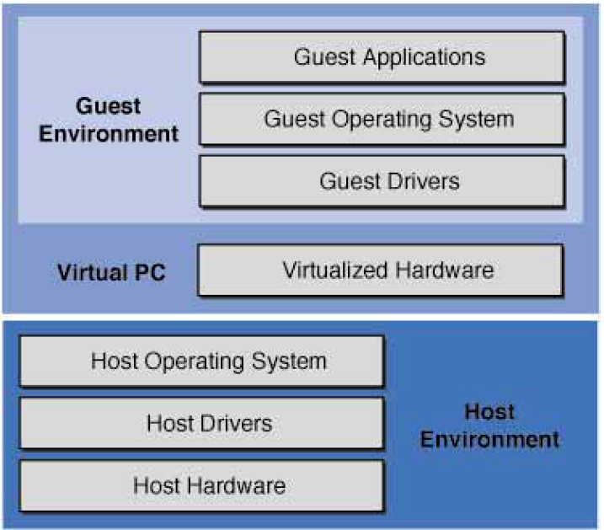
Virtualization Layers

Slide 5
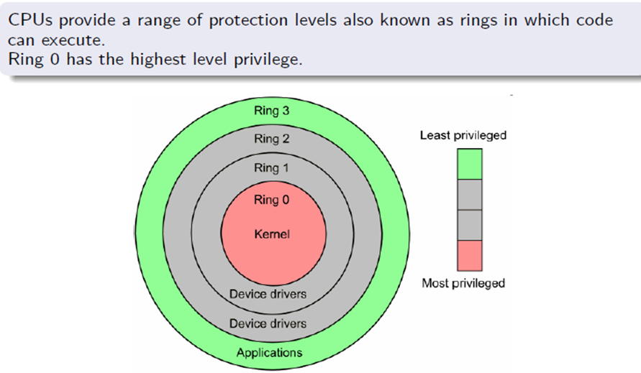
Privilege Rings

Slide 6
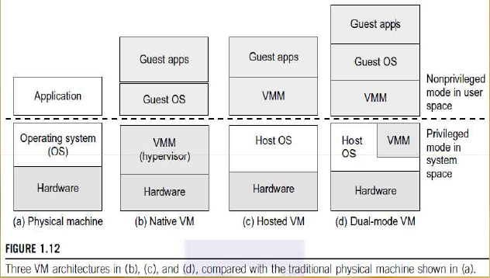
Virtual Machines and Virtualization Middleware

Slide 7
Types of Virtualization
We mainly focus on Platform virtualization which is mostly related to cloud-computing [1]
Full virtualization with Binary translation
Para-Virtualization with Compiler support
Hardware-assisted virtualization
OS-level virtualization

Slide 8
Virtualization Structure Tools and Mechanisms
Full Virtualization with Binary Translation
Para-Virtualization with Compiler Support

Slide 9
Binary translation
Binary translation is one specific approach to implementing full virtualization
It involves examining the executable code of the virtual guest for “unsafe” instructions, translating these into “safe” equivalents, and then executing the translated code.
An unsafe instruction is one that for example tries to access or modify the memory of another guest.

Slide 10
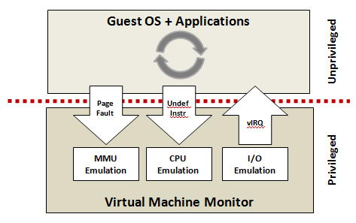
Trap and Emulate

Slide 11
Binary translation
Trap & Emulate : Executable code from the guest is allowed to execute directly on the host CPU by the hypervisor
A Trap is an exceptional condition that transfers control back to the hypervisor.
Once the hypervisor has received a trap, it will inspect the offending instruction, Emulate it in a safe way, and continue execution after the instruction
Disadvantage: It is time-consuming and degrades the performance.

Slide 12
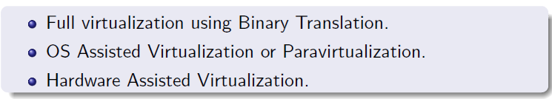
Virtualization Techniques

Slide 13
Full Virtualization / Host-based Virtualization
Full Virtualization provides complete simulation of the underlying hardware.
Simulate all computing elements such as instruction set, main memory, interrupts, exceptions, and device access.
The result is a system in which all software (including all OS’s) capable of execution on the raw hardware can be run in the virtual machine
The combination of binary translation and direct execution provides Full Virtualization as the guest OS is fully abstracted (completely decoupled) from the underlying hardware by the virtualization layer.
The guest OS is not aware it is being virtualized and requires no modification.

Slide 14
Full Virtualization
The hypervisor translates all operating system instructions on the fly and caches the results for future use, while user level instructions run unmodified at native speed.
Full Virtualization is done at run time.
Examples
VMware
Microsoft Virtual Server
Full virtualization has proven highly successful
Sharing a computer system among multiple users
Isolating users from each other (and from the control program) and
Emulating new hardware to achieve improved reliability, security and productivity.

Slide 15
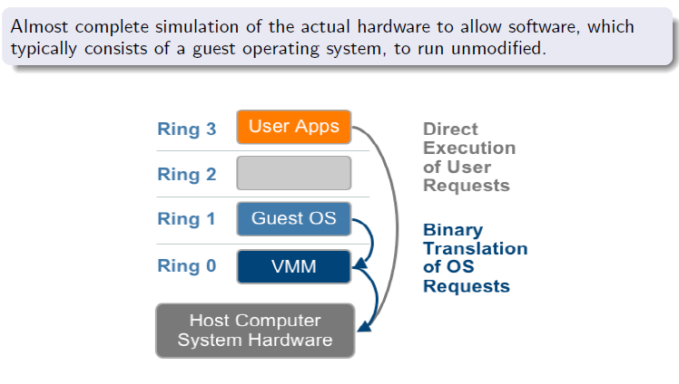
Full Virtualization with Binary translation
VMM: Virtual Machine Monitor

Slide 16
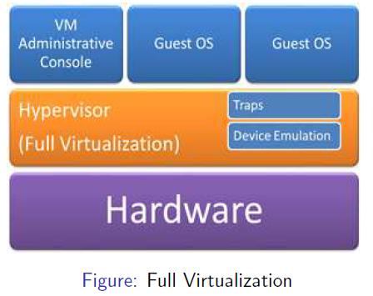
Full Virtualization

Slide 17
Full Virtualization
Advantages:
It is flexible
Guest OS is decoupled from Hardware and unaware that it is virtualized.
Disadvantages:
It may be slow.
Binary Translation incurs time which affects performance.
Full Virtualization of I/O intensive applications is a big challenge.

Slide 18
Full Virtualization
Full Virtualization can be done in two forms
1. Bare- Metal Virtual Machine (Native VM)
2. Hosted Virtual Machine (Host-Based Virtualization)

Slide 19
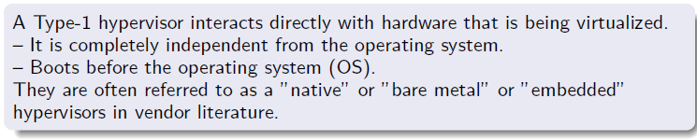
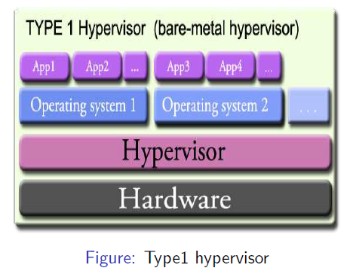
Types of Hypervisor – Bare-Metal VM

Slide 20
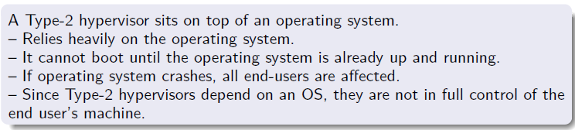
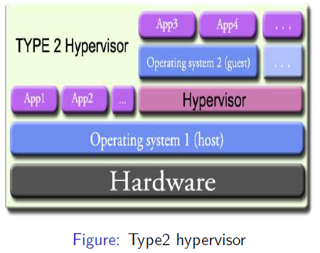
Types of Hypervisor- Hosted VM Host-Based Virtualization

Slide 21
Types of Hypervisor- Hosted VM Host-based Virtualization
Advantages:
User installs VM architecture without modifying Host OS.
More Flexible
Host Based Virtualization appeals to many host machine configuration.
Disadvantages:
It may be slow.
Accessing hardware involves four layer mapping which degrades performance.
Requires Binary Translation when ISA of guest is different from ISA of host.

Slide 22
OS assisted (Para-virtualization)
Para-virtualization – via an modified OS kernel as guest OS
To overcome the problem of degraded performance, Guest OS kernel is modified.
Para-virtualization is assisted with intelligent compiler to replace non-virtualizable instructions with hypercalls that communicate directly with the virtualization layer or hypervisor.
Para-virtualization is different from full virtualization, where the unmodified OS does not know it is virtualized and sensitive OS calls are trapped using binary translation.
Para-Virtualization is done at Compile time.
Example:
Xen -- modified Linux kernel and a version of Windows XP
KVM (Kernel-based Virtual Machine) and VMware ESX

Slide 23
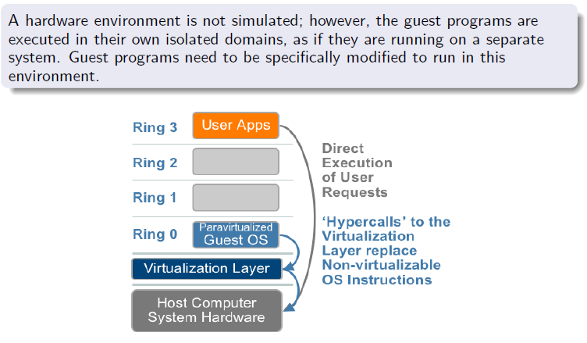
OS assisted (Para-virtualization)
VMM: Virtual Machine Monitor

Slide 24
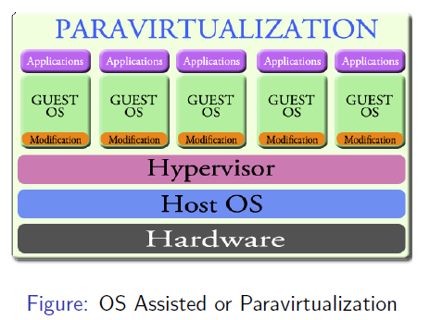
OS assisted (Para-virtualization)

Slide 25
OS assisted (Para-virtualization)
Advantages
It eliminates Binary Translation
It is relatively easy and more practical.
Disadvantages
Para-virtualization cannot support unmodified OS
Compatibility and portability is doubt.
Maintaining Para-Virtualization is high as it required deep OS kernel modification.

Slide 26
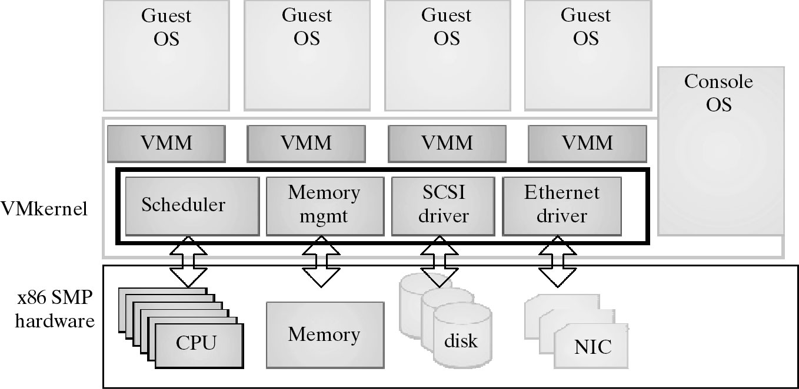
VMware ESX Server : Para-virtualization)

Slide 27
Hardware Assisted Virtualization
Processor run multiple processes. All instructions from process will access hardware directly.
Processors have two modes. Supervisor and User modes.
Instructions running in supervisor mode are privileged instructions. Others are unprivileged instructions.
Processor such as x86 employ a special running mode called root mode.
VMM and Guest OS run in different modes.
All sensitive instructions of guest OS and its applications are trapped in VMM.

Slide 28
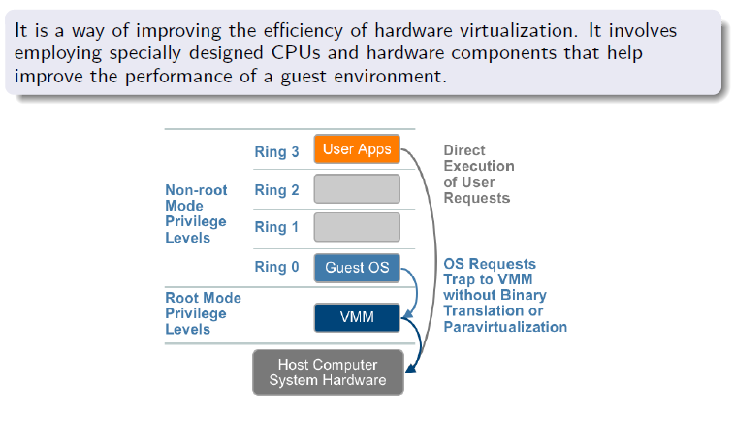
Hardware Assisted Virtualization
VMM: Virtual Machine Monitor

Slide 29
Hardware Assisted Virtualization
This is also known as Accelerated Virtualization, hardware virtual machine (Xen), native virtualization (Virtual iron).
Hardware switch supported by CPU, e.g.
Intel Virtualization Technology (VT-x)
AMD’s AMD-V
Intel and AMD add an additional mode to x86 processor.
OS run in Ring 0 and Hypervisor run below Ring 0.
Target privileged instructions with a new CPU execution mode
feature allows the VMM to run in a new root mode below Ring 0.
Privileged and sensitive calls are set to automatically trap to the hypervisor, removing the need for either Binary Translation or OS modification (Para-Virtualization)

Slide 30
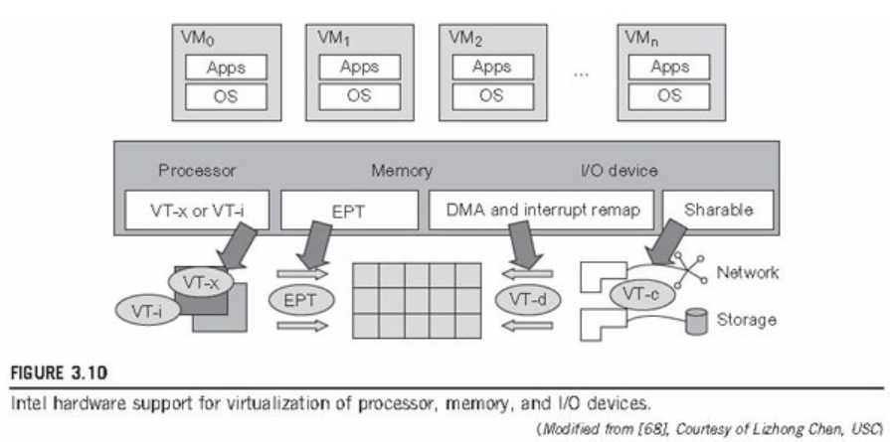
Hardware Assisted Virtualization

Slide 31
Hardware Assisted Virtualization
KVM (Kernel-based Virtual Machine) is a Linux kernel virtualization infrastructure.
KVM can support hardware-assisted virtualization and para-virtualization by using the Intel VT-x or AMD-v and VirtIO framework, respectively.
The VirtIO framework includes a para-virtual Ethernet card, a disk I/O controller, a balloon device for adjusting guest memory usage.
VGA graphics interface using VMware drivers.

Slide 32
Hardware Assisted Virtualization
Advantages
Removes difficulty of Binary Translation of Full Virtualization and lets the OS to run VMs without modification.
Disadvantages
Transition from Hypervisor to Guest OS incurs high overhead switches between processor modes.
Virtualization such as VMware uses hybrid approach
Few tasks are offloaded to hardware and others are done with software.
Para-Virtualization and hardware-assisted virtualization can be combined together to improve performance

Slide 33
Virtualization of CPU, Memory & IO
CPU Virtualization
Memory Virtualization
IO Virtualization

Slide 34
CPU Virtualization
A VM is a duplicate of an existing computer system
Majority of the VM instructions are executed on the host processor in native mode.
Unprivileged instructions of VMs run directly on the host machine for higher efficiency.
Other critical instructions should be handled carefully for correctness and stability.
Critical Instructions are divided as privileged instructions, control-sensitive instructions, and behavior-sensitive instructions.

Slide 35
CPU Virtualization
Critical Instructions:
Privileged instructions execute in a privileged mode and will be trapped if executed outside this mode.
Control-sensitive instructions attempt to change the configuration of resources used.
Behavior-sensitive instructions have different behaviors depending on the configuration of resources, including the load and store operations over the virtual memory.

Slide 36
CPU Virtualization
VM’s privileged and unprivileged instructions run in the CPU’s user mode while the VMM runs in supervisor mode.
When the privileged instructions including control- and behavior-sensitive instructions of a VM are executed, they are trapped in the VMM.
Not all CPU architectures are virtualizable. RISC CPU architectures can be naturally virtualized because all control and behavior-sensitive instructions are considered privileged instructions.
On the contrary, x86 CPU architectures are not primarily designed to support virtualization.
This is because about 10 sensitive instructions, such as SGDT and SMSW, are not privileged instructions. They modify the global memory segments.
When these instructions execute in virtualization, they cannot be trapped in the VMM.
Binary Translation need to be implemented. (Full Virtualization)

Slide 37
CPU Virtualization
Solution: Hardware-Assisted CPU Virtualization
Intel and AMD add an additional mode called privilege mode level (some people call it Ring-1) to x86 processors.
Therefore, operating systems can still run at Ring 0 and the hypervisor can run at Ring -1.
All the privileged and sensitive instructions are trapped in the hypervisor automatically.
This technique removes the difficulty of implementing binary translation of full virtualization.
It also lets the operating system run in VMs without modification.

Slide 38
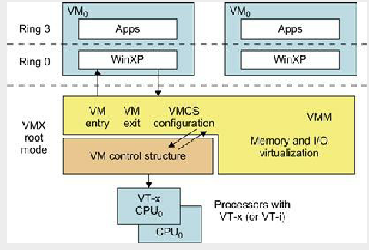
CPU Virtualization
Solution: Hardware-Assisted CPU Virtualization

Slide 39
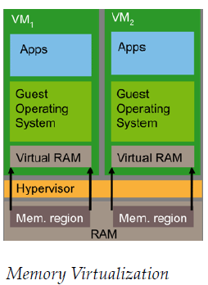
Memory Virtualization
To run multiple virtual machines on a single system, another level of memory virtualization is required.
This involves sharing the physical system memory and dynamically allocating it to virtual machines.
Not only virtual memory
Hardware support
e.g., x86 MMU and TLB

Slide 40
Memory Virtualization
The guest OS continues to control the mapping of virtual addresses to the guest memory physical addresses using Page Table
The guest OS cannot have direct access to the actual machine memory.
The VMM is responsible for mapping guest physical memory to the actual machine memory, and it uses shadow page tables to accelerate the mappings.
VMM uses TLB hardware to map the virtual memory directly to the machine memory to avoid the two levels of translation on every access. (as indicated by red line in next slide fig)

Slide 41
Memory Virtualization
When the guest OS changes the virtual memory to physical memory mapping, the VMM updates the shadow page tables to enable a direct lookup.
The shadow page table controls which pages of machine memory are assigned to a given VM
VM1
VM2
Process 1
Process 2
Process 1
Process 2
Virtual memory
Guest OS , Page Table
Physical memory
VMM
Shadow Page Table
TLB
Machine memory

Slide 42
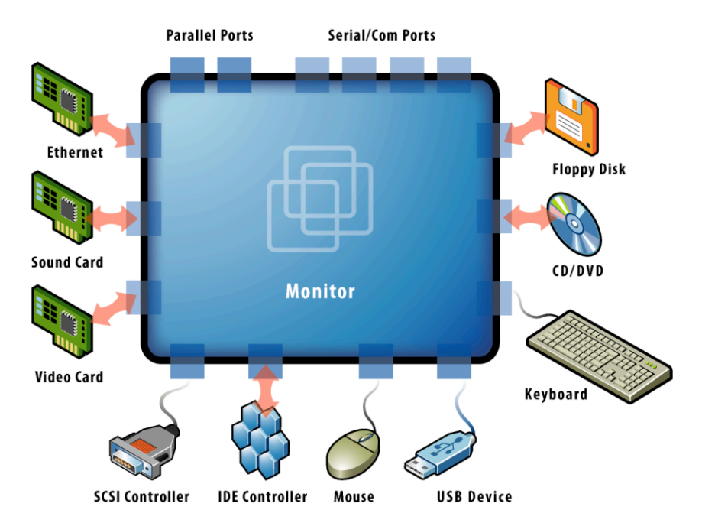
Device and I/O Virtualization
VMM supports all device/IO drivers
Physically/virtually existed
Source: VMware white paper, “Understanding Full Virtualization, Paravirtualization, and Hardware Assist”

Slide 43
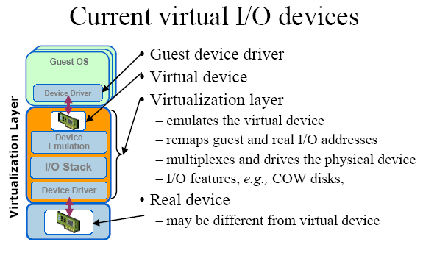
Device and I/O Virtualization

Slide 44
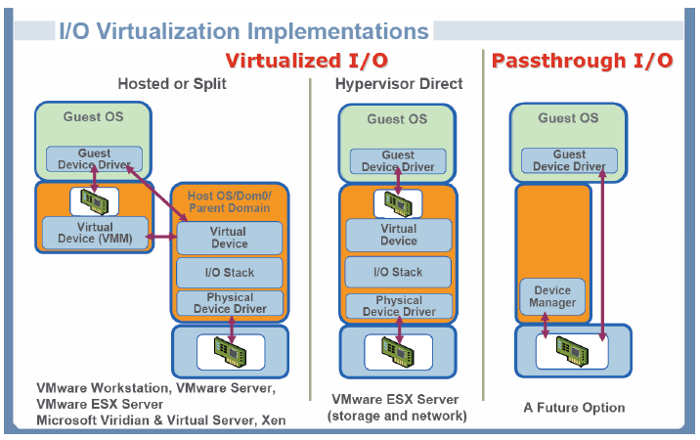
Device and I/O Virtualization
Para- Virtualized I/O:
Frontend driver manages I/O from Guest OS. Backend driver manages real I/O devices
Full Device emulation: Replication of all devices is done in a software.
S/w is located in VMM
Direct I/O:
VM access device directly. It is challenging task

Slide 45
Conclusions on CPU, Memory and I/O Virtualization
CPU virtualization demands hardware-assisted traps of sensitive instructions by the VMM
Memory virtualization demands special hardware support (shadow page tables by VMWare or extended page table by Intel) to help translate virtual address into physical address and machine memory in two stages.
I/O virtualization is the most difficult one to realize due to the complexity of I/O service routines and the emulation needed between the guest OS and host OS

Slide 46
Conclusions on Full , Para and Hardware –assisted Virtualization
Full virtualization at the hardware level has the disadvantages of slow performance and low density
Need for Para-Virtualization is to modify the guest OS.
To reduce the performance overhead of hardware level virtualization, even hardware modification is needed
OS-level virtualization provides a feasible solution for these hardware-level virtualization issues

Slide 47
OS-Level Virtualization
OS-level virtualization
Operating system level virtualization inserts a virtualization layer inside an operating system to partition a machine’s physical resources.
It enables multiple isolated VMs within a single operating system kernel.
This kind of VM is often called a Virtual execution Environment (VE), Virtual Private System (VPS), or simply container
OS-Level Virtualization
OS
Container 1
OS
Container 2
OS
Container 3
OS virtualization
layer
Standard
Host OS
Hardware

Slide 48
OS-Level Virtualization
OS-level virtualization
An OS-level virtualization approach doesn't use a hypervisor at all.
Instead, the virtualization capability is part of the host OS, which performs all the functions of a fully virtualized hypervisor.
OS-Level Virtualization
OS
Container 1
OS
Container 2
OS
Container 3
OS virtualization
layer
Standard
Host OS
Hardware

Slide 49
OS-Level Virtualization
OS-level virtualization
From the user’s point of view, VEs look like real servers.
This means a VE has its own set of processes, file system, user accounts, network interfaces with IP addresses, routing tables, firewall rules, and other personal settings.
Although VEs can be customized for different people, they share the same operating system kernel.
Therefore, OS-level virtualization is also called single-OS image virtualization..
OS-Level Virtualization
OS
Container 1
OS
Container 2
OS
Container 3
OS virtualization
layer
Standard
Host OS
Hardware

Slide 50
OS-Level Virtualization
OS-level virtualization
The biggest limitation of this approach is that all the guest servers must run the same OS.
Each virtual server remains independent from all the others, but you can't mix and match operating systems among them.
Because all the guest operating systems must be the same, this is called a homogeneous environment.
OS-Level Virtualization
OS
Container 1
OS
Container 2
OS
Container 3
OS virtualization
layer
Standard
Host OS
Hardware

Slide 51
Confusion…
OS-Level Virtualization. A type of server virtualization technology which works at the OS layer. The physical server and single instance of the operating system is virtualized into multiple isolated partitions, where each partition replicates a real server. The OS kernel will run a single operating system and provide that operating system functionality to each of the partitions.
Operating system virtualization refers to the use of software to allow system hardware to run multiple instances of different operating systems concurrently, allowing you to run different applications requiring different operating systems on one computer system. The operating systems do not interfere with each other or the various applications.

Slide 52
Summary of Virtualization Types
Binary translation is the most established technology for full virtualization
Hardware assist is the future of virtualization, but it still has a long way to go
Para-Virtualization delivers performance benefits with maintenance costs
Xen
VMWare

Slide 53
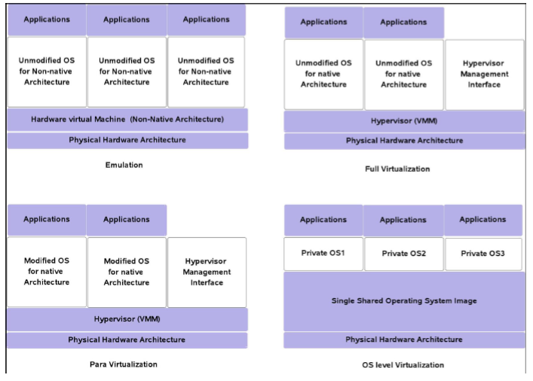
Types of Virtualization

Slide 54
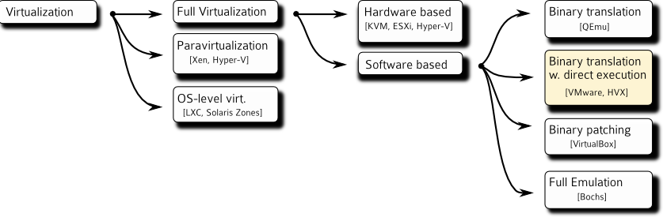
Virtualization Taxonomy

Slide 55
Techniques for X86 virtualization
 | Full Virtualization with Binary Translation | Hardware Assisted Virtualization | OS Assisted Virtualization / Paravirtualization
Technique | Binary Translation and Direct Execution | Exit to Root Mode on Privileged Instructions | Hypercalls
Guest Modification / Compatibility | Unmodified Guest OS Excellent compatibility | Unmodified Guest OS Excellent compatibility | Guest OS modified to issue Hypercalls . So it can't run on Native Hardware or other Hypervisors Poor compatibility; Not available on Windows OSes
Performance | Good | Fair Current performance lags Binary Translation virtualization on various workloads but will improve over time | Better in certain cases
Used By | VMware, Microsoft, Parallels | VMware, Microsoft, Parallels, Xen | VMware, Xen
Guest OS Hypervisor Independent? | yes | yes | XenLinux runs only on Xen Hypervisor VMI-Linux is Hypervisor agnostic
Source: VMware white paper, “Understanding Full Virtualization, Paravirtualization, and Hardware Assist”

Slide 56
Importance of Virtualization in Cloud
Cloud can exist without Virtualization, although it will be difficult and inefficient.
Cloud makes notion of ”Pay for what you use” and ”infinite availability- use as much as you want”.
These notions are practical only if we have
– lot of flexibility.
– efficiency in the back-end.
This efficiency is readily available in Virtualized Environments and Machines.
Virtualization is not necessary to create a cloud environment, but it enables rapid scaling of resources in a way that non-virtualized environments find hard to achieve.

Slide 57
Disadvantages of Virtualization
Specific hardware requirements
Upfront cost
Some programs don’t take Virtualization
VMs need lot of power
You still need those old desktops
You will need fast network
Computing is virtual, peripherals are real.
Some hardware architectures or features are impossible to virtualize such as:
– Certain registers or state not exposed
– Clocks, time, and real-time behavior
Virtualization may not work well for :
Resource-intensive applications
–VMs may have RAM/CPU limitations
Performance testing
Hardware compatibility testing

Slide 58
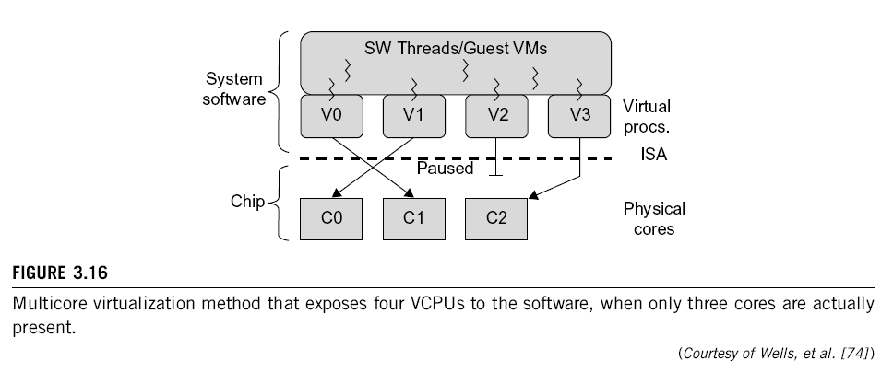
Multi-Core Virtualization: VCPU vs. traditional CPU
Figure 3.16 Four VCPUs are exposed to the software, only three cores are actually present. VCPUs V0, V1, and V3 have been transparently migrated, while VCPU V2 has been transparently suspended. (Courtesy of Wells, et al., “Dynamic Heterogeneity and the Need for Multicore Virtualization”, ACM SIGOPS Operating Systems Review, ACM Press, 2009 [68] )

Slide 59
Virtual Cores vs. Physical Processor Cores
Physical cores | Virtual cores
The actual physical cores present in the processor. | There can be more virtual cores visible to a single OS than there are physical cores.
More burden on the software to write applications which can run directly on the cores. | Design of software becomes easier as the hardware assists the software in dynamic resource utilization.
Hardware provides no assistance to the software and is hence simpler. | Hardware provides assistance to the software and is hence more complex.
Poor resource management. | Better resource management.
The lowest level of system software has to be modified. | The lowest level of system software need not be modified.

Slide 60
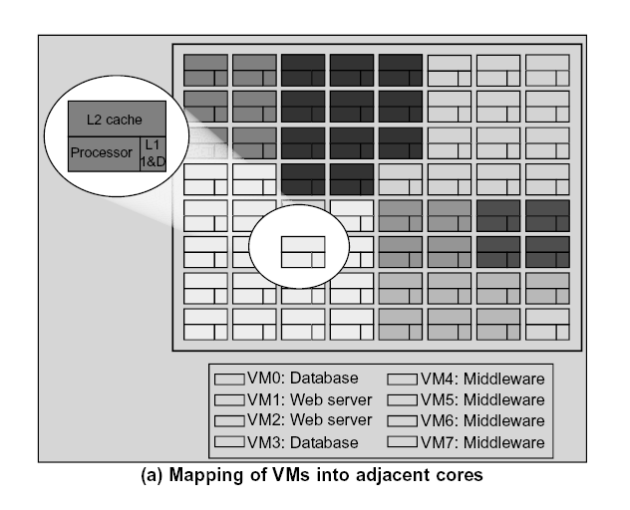
CMP Server consolidation by Space-sharing of VMs
(Courtesy of Marty and Hill, 2007)

Slide 61
Virtual Clusters in Many Cores Space Sharing of VMs -- Virtual Hierarchy
(Courtesy of Marty and Hill, 2007)

Slide 62
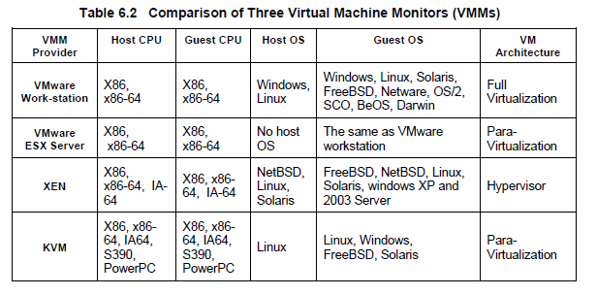
Major VMM and Hypervisor Providers

Slide 63
Summary
Virtualization
Virtualization Structure Tools and Mechanisms
Virtualization of CPU Memory and IO
Importance of Virtualization in Cloud
Disadvantages of Virtualization

Slide 64
References
“Understanding Full, Para and Hardware Assisted Virtualization,” www.vmware.com/files/pdf/VMware paravirtualization.pdf.
http://www.computerworld.com/article/2551154/virtualization/emulation-or-virtualization-.html
http://www.ravellosystems.com/blog/nested-virtualization-with-binary-translation/
“OVA-open-virtualization-alliance,” https://openvirtualizationalliance.org/.
http://www.xen.org/
“Open Virtualization Format for Virtual Machines”, available at http://www.vmware.com/appliances/getting-started/learn/ovf.html
M. Marty, M. Hill, Virtual hierarchies to support server consolidation, in: Proceedings of the 34th Annual International Symposium on Computer Architecture (ISCA), 2007.

Slide 65
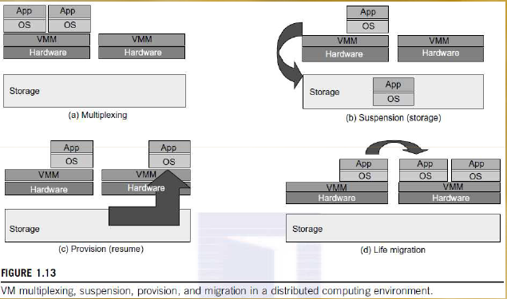
Primitive Operations in Virtual Machines

Slide 66
Implementation Levels of Virtualization
Levels of Virtualization Implementation
VMM Design Requirements and Providers
Virtualization Support at the OS Level
OS-Level Virtualization
Middleware Support for Virtualization
CUDA & vCUDA

Slide 67
Virtualization Structures/Tools and Mechanisms
Hypervisor and Xen Architecture
Binary Translation with Full Virtualization
Para-Virtualization with Compiler Support

Slide 68
Virtualization of CPU, Memory, and I/O Devices
Hardware Support for Virtualization
CPU Virtualization
Memory Virtualization
I/O Virtualization
Virtualization in Multi-Core Processors

Slide 69
Thank You
Kingsoft Office

